Slide 1
Human Rights and Internet governance

Slide 2
This talk
Introduction
What is Internet governance?
Internet Engineering Task Force (IETF)
Internet Corporation for Assigned Names and Numbers (ICANN)
Advocacy & Human rights 3.0?
Q&A

Slide 3
Introduction
Current:
PhD Candidate Oxford Internet Institute & Alan Turing Institute for Data Science
Human rights consultant for various NGOs working on Internet governance.
Research: human rights in Internet governance
T: @C_Cath
E: ccath@turing.ac.uk
Former:
Program Officer human rights NGO ARTICLE 19

Slide 4
What is the Internet?
A network of networks that can interoperate.

Slide 5
What is Internet governance?
No single definition, but broadly refers to:
The development, coordination, and management of a broad range of principles, policies, and technical standards that determine how the Internet operates and evolves over time.

Slide 6
Most people

Slide 7
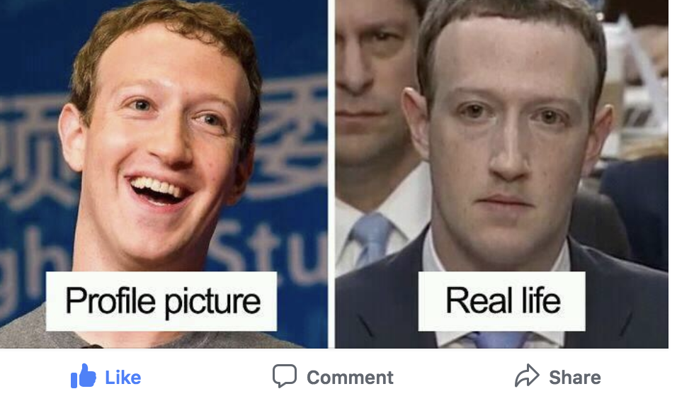
This guy

Slide 8
These problems

Slide 9
Tip of the Iceberg

Slide 10
One layer of the Internet cake

Slide 11
A Taxonomy

Slide 12
The Logical Layer
**bonus points if you can tell me what is no longer the case in this picture**
Burrington, 2016

Slide 13
What happens at the logical layer?
Many things.
Some of which are pretty crucial for global interoperability.

Slide 14
Why do we rarely hear about these organizations?
Because there is limited direct interaction between what these organizations do and ”end-users”
Because it is very technical and in the background
Because these organizations are away from the limelight
(Even though that is increasingly hard).

Slide 15
Internet Engineering Task Force (IETF)
Started in 1986, meet 3 times a year, anyone can join.
Makes standards & protocols that enable interoperability, which allow networks to interoperate.
Familiar examples:
Hyper text transfer protocol secure (HTTPS) – communication with website
Simple Mail Transfer Protocol (SMTP) – email transmission
These standards can impact the exercise of human rights.

Slide 16
For Example: Hyper text transfer protocol secure (HTTPS)

Slide 17
Human rights efforts at the IETF
Since it beginning cognizant of political-economic rights like privacy (Braman, 2017)
Civil society has been active within it since the 00’s, but unstructured
2014 human rights protocol considerations group created
2017 human rights protocol considerations Request for Comments (RFC) 8280 published (*first ever*) guidelines
Public Interest Group formed: coalition of civil society actors in the IETF

Slide 18
ICANN
Formed in 1998, meet 3 times per year, anyone can join.
Does the management and technical maintenance of the databases related to the namespaces of the Internet, that allow you to find content.
Set policies around top level domains, like .gay, .islam, .ninja
These policies can impact the exercise of human rights.

Slide 19
For example: .controversies
Amazon, the company, applied and initially got the .amazon tld
Peru, Brazil and Bolivia objected because they consider it to be a protected geographic term (this is ICANN policy normally)
Ongoing discussion
Similar discussions have been had over .gay and .islam

Slide 20
Human rights efforts at ICANN
Since it beginning cognizant of political-economic rights like privacy (Mueller, 2002)
Non-Commercial Users Constituency (NCUC)
2014 report by the Council of Europe on ICANN & human rights
2015 Cross-Community Working Party on Human Rights
2016 Human Rights bylaw in the new bylaws of ICANN
Currently, developing human rights impact assessments for ICANN

Slide 21
The logical layer matters because:
It defines the rules of the road for information flows
It is the digital infrastructure of the Internet
Its invisible and difficult to regulate consistently
Influence in it means having both territorial and extraterritorial impact on information flows & Internet infrastructure

Slide 22
Code = Law, thus code needs human rights advocacy?
Lessig, 2006

Slide 23
Advocacy & Human rights 3.0?
The Internet increasingly underpins diverse facets of society (surface increase)
Human rights questions increasingly play out in Internet design & code (friction increase)
We need a new human rights advocacy for code ?
Current efforts are focused on highlighting the issue and suggesting ways for Internet governance organizations to respect human rights.

Slide 24
It’s complicated
Non-state actors
”only” have the RUGGIE principles, some national law
A lot more can be done (see all UNSR Kaye’s reports)
How do we address socio-economic impact of Internet governance?

Slide 25
Q&A

Slide 26
References
Braman, Sandra. (2017). Internet histories: The view from the design process, Internet Histories, 1(1), 70-78.
Burrington, 2016. https://splinternews.com/who-controls-the-internet-ted-cruzs-fantasy-vs-the-re-1793861684
Cath, Corinne. (forthcoming). Human Rights and Internet governance.
Council of Europe ICANN report. (2014). ICANN’s procedures and policies in the light of human rights, fundamental freedoms and democratic values.
Choucri, Nazli, and David D. Clark. 2012. ‘Who Controls Cyberspace?’ Bulletin of the Atomic Scientists 69 (5): 21–31. https://doi.org/10.1177/0096340213501370.
Lessig, Lawrence. 2006. Code: And Other Laws of Cyberspace, Version 2.0. New York: Basic Books.
Mueller, Milton. 2002. Ruling the Root: Internet Governance and the Taming of Cyberspace. Cambridge MA: MIT Press.

